Slide 1
Deferred Shading
Patrick Cozzi
University of Pennsylvania
CIS 565 - Fall 2014

Slide 2
Renderer Design
Design an engine that renders lots of
Objects with different materials
Dynamic lights
Different light types
Cleanly. Efficiently.
Notes:
Light types – point, spot, directional, etc.

Slide 3
Forward Rendering – Multi-Pass
foreach light
{
foreach visible object
{
Render using shader for
this material/light;
accumulate in framebuffer;
}
}
Pros and cons?
Notes:
How do we accumulate? Blending.

Slide 4
Forward Rendering – Multi-Pass
One shader per material/light-type
Performance
Need to do vertex transform, rasterization, material part of fragment shader, etc. multiple times for each object.
Occluded fragments are shaded
Not all lights affect the entire object
Notes:
Front-to-back and/or z-prepass can reduce/eliminate shading occluded fragments
Occluded fragments are shaded without a z-prepass.
Not all lights affect the entire object (performance)

Slide 5
Forward Rendering – Single Pass
foreach visible object
{
find lights affecting object;
Render all lights and materials using a single shader;
}
Pros and cons?

Slide 6
Forward Rendering – Single Pass
Lots of shaders
One shader per material/light-combination
Hard to author shaders
May require runtime compile/link
Long ubershader increase compile times
More potential shaders to sort by
Same as multi-pass
Occluded fragments are shaded
Not all lights affect the entire object
Notes:
Can’t compile in advance since there are so many combinations.
Front-to-back and/or z-prepass can reduce/eliminate shading occluded fragments
Occluded fragments are shaded without a z-prepass.
Not all lights affect the entire object (performance)

Slide 7
Deferred Rendering
foreach visible object
{
write properties to g-buffer;
}
foreach light
{
compute light using g-buffer;
accumulate in framebuffer;
}
Pros and cons?

Slide 8
Deferred Rendering
Decouple lighting from scene complexity
Few shaders
One per material
One per light type
Only transform and rasterize each object once
Only light non-occluded objects
Notes:
Lighting does not depend on the number of objects

Slide 9
Deferred Rendering
Memory bandwidth usage - read g-buffer for each light
Recalculate full lighting equation for each light
Limited material properties in g-buffer
MSAA and translucency are difficult
Notes:
Does not handle transparent objects? Why? We only have g-buffer for front-most fragment.

Slide 10
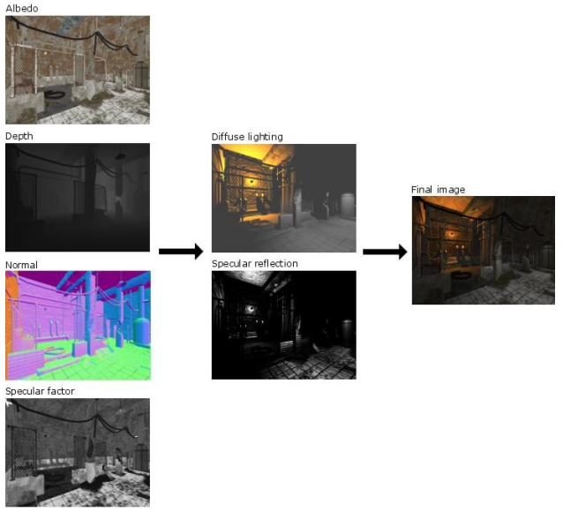
G-Buffer Layout in Leadwerks 2.1
Image from http://www.leadwerks.com/files/Deferred_Rendering_in_Leadwerks_Engine.pdf
Notes:
“Depth, normal, and specular factor are used to calculate diffuse lighting and specular reflection, which is then combined with the albedo color for the final image.”

Slide 11
G-Buffer Layout in Leadwerks 2.1
Image from http://www.leadwerks.com/files/Deferred_Rendering_in_Leadwerks_Engine.pdf
Notes:
The position is reconstructed from the fragment position and depth.

Slide 12
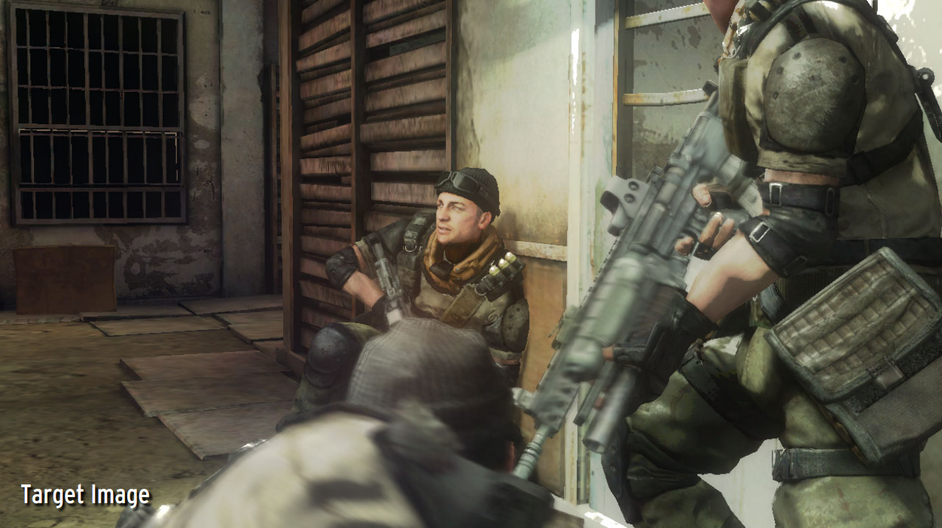
G-Buffer Layout in Killzone 2
Image from http://www.guerrilla-games.com/publications/dr_kz2_rsx_dev07.pdf

Slide 13
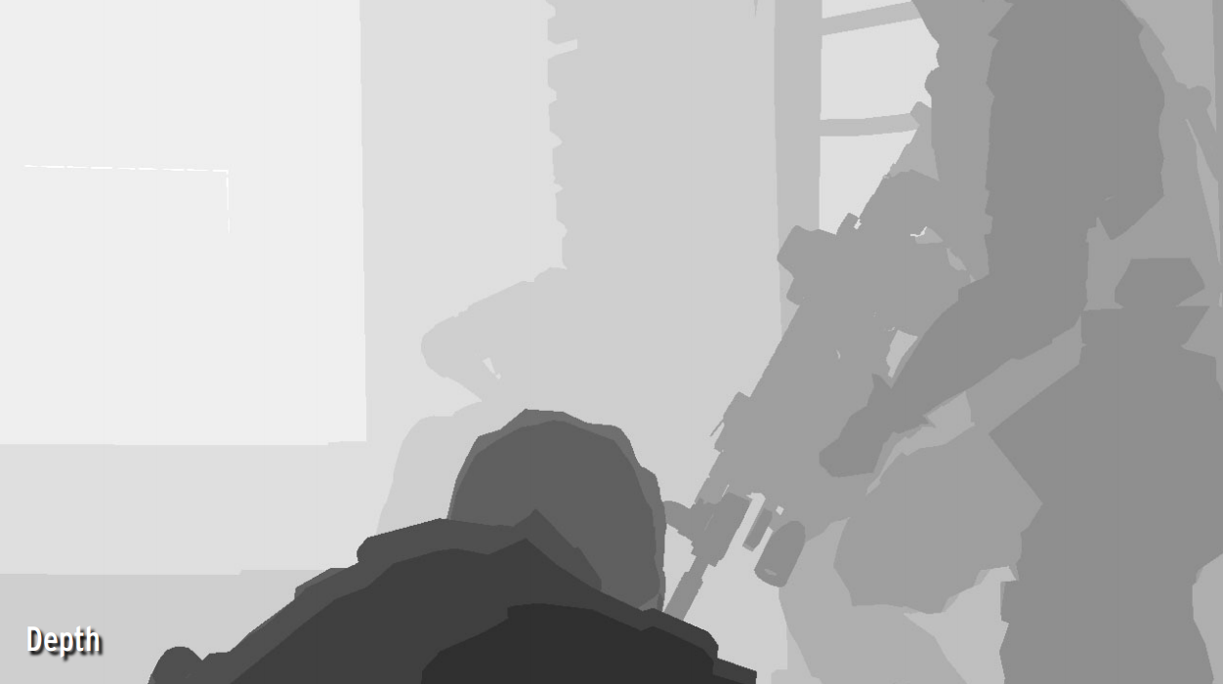
G-Buffer Layout in Killzone 2
Image from http://www.guerrilla-games.com/publications/dr_kz2_rsx_dev07.pdf

Slide 14
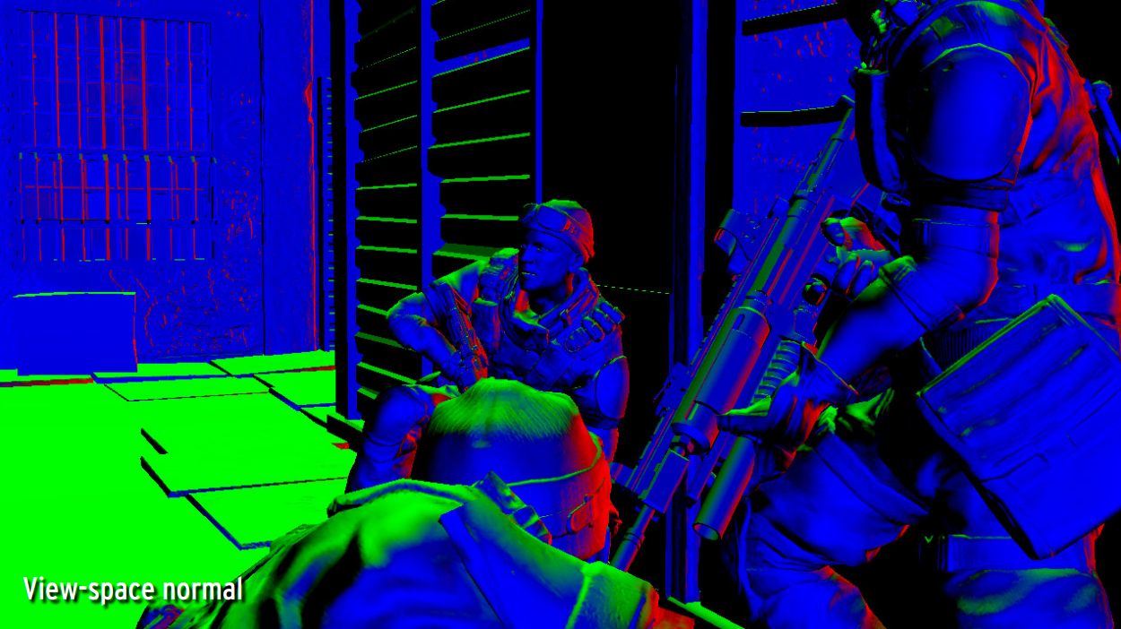
G-Buffer Layout in Killzone 2
Image from http://www.guerrilla-games.com/publications/dr_kz2_rsx_dev07.pdf

Slide 15
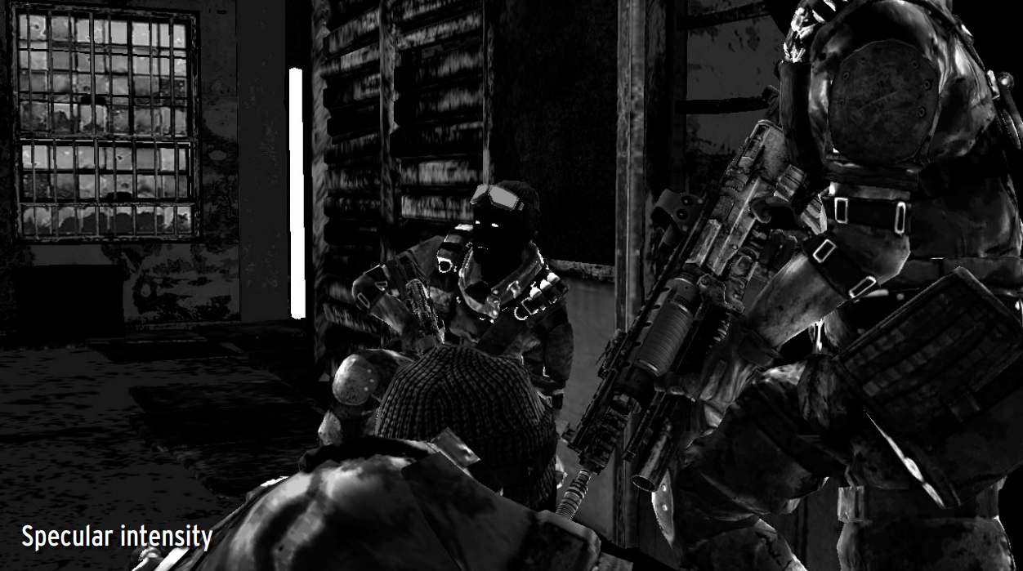
G-Buffer Layout in Killzone 2
Image from http://www.guerrilla-games.com/publications/dr_kz2_rsx_dev07.pdf

Slide 16
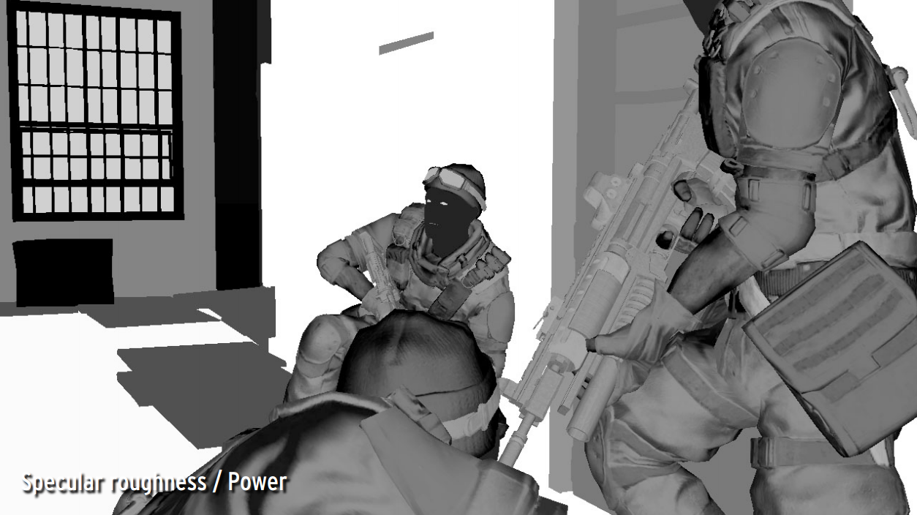
G-Buffer Layout in Killzone 2
Image from http://www.guerrilla-games.com/publications/dr_kz2_rsx_dev07.pdf

Slide 17
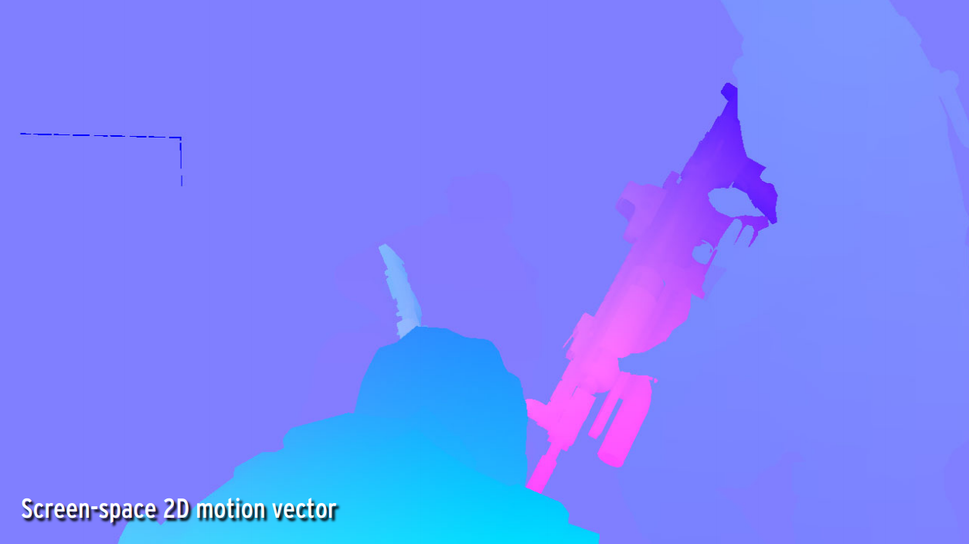
G-Buffer Layout in Killzone 2
Image from http://www.guerrilla-games.com/publications/dr_kz2_rsx_dev07.pdf

Slide 18
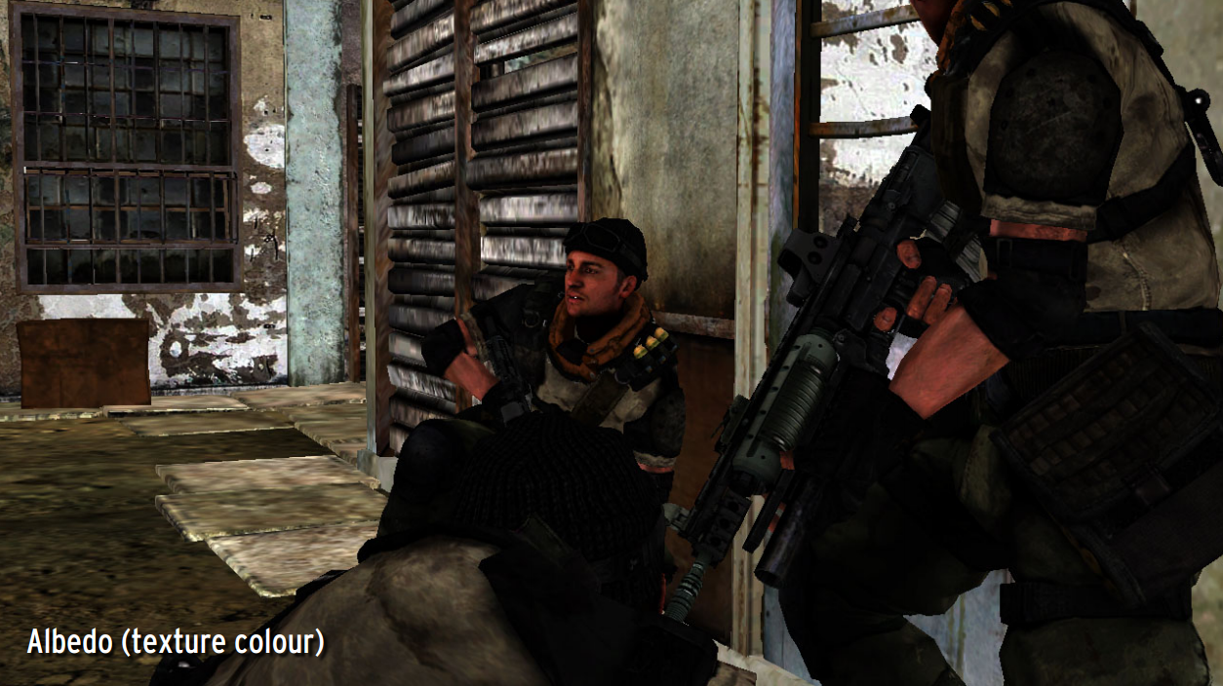
G-Buffer Layout in Killzone 2
Image from http://www.guerrilla-games.com/publications/dr_kz2_rsx_dev07.pdf

Slide 19
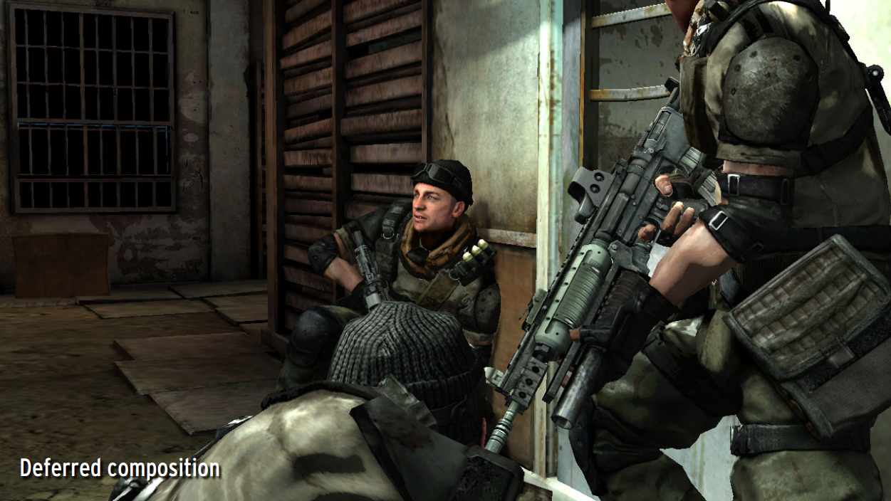
G-Buffer Layout in Killzone 2
Image from http://www.guerrilla-games.com/publications/dr_kz2_rsx_dev07.pdf

Slide 20
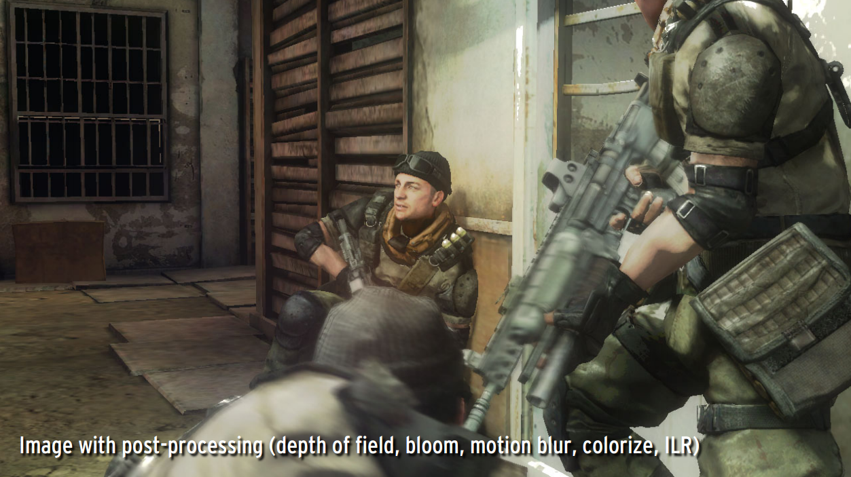
G-Buffer Layout in Killzone 2
Image from http://www.guerrilla-games.com/publications/dr_kz2_rsx_dev07.pdf

Slide 21
G-Buffer Layout in Killzone 2
Image from http://www.guerrilla-games.com/publications/dr_kz2_rsx_dev07.pdf
Notes:
* DS: 24-bit depth, 8-bit stencil
* RT0-RT3: 32-bit RGBA
* Light accumulation is output
* Normal Z is reconstructed since it is normalized
* Motion vector is in screen-space
* Specular power - stored as log2(original)/10.5 - High range and still high precision for low shininess
* Sun Occlusion - pre-rendered static sun shadows - Mixed with real-time sun shadow for higher quality

Slide 22
Light Accumulation Pass
Geometry for each light
Full-screen quad/triangle
with scissor/stencil test
3D bounding geometry. Examples:
Point light – sphere
Spot light – cone
Needs multiple passes. Why?
Notes:
Using geometry increases the vertex load but can decrease the fragment load since it can provide a tighter fit around the light’s area of influence. Some lights, like the sun, may not have bounding geometry and are better served by a full-screen quad.
Killzone 2 uses two passes and the stencil buffer to determine lit pixels, and a third pass to finally do lighting. I’m skipping the middle pass since we’re not covering shadows.

Slide 23
WebGL Demo
https://hacks.mozilla.org/2014/01/webgl-deferred-shading/
Notes:
More reading: http://floored.com/blog/2014/webgl-deferred-shading-gbuffer-floating-point-texture.html

Slide 24
References
Deferred Rendering in Killzone 2 – Michal Valient
http://www.guerrilla-games.com/publications/dr_kz2_rsx_dev07.pdf
Deferred Rendering in Leadwerks Engine - Josh Klint
http://www.leadwerks.com/files/Deferred_Rendering_in_Leadwerks_Engine.pdf
Light Pre-Pass – Wolfgang Engel
http://www.slideshare.net/cagetu/light-prepass
Compact Normal Storage for Small G-Buffers – Aras Pranckevičius
http://aras-p.info/texts/CompactNormalStorage.html

