Slide 1
Final Project Ideas
Patrick Cozzi
University of Pennsylvania
CIS 565 - Fall 2014

Slide 2
Previous Semesters
Fall 2013 - http://cis565-fall-2013.github.io/studentwork.html
Fall 2012 - http://cis565-fall-2012.github.io/studentwork.html
Spring 2012 - http://cis565-spring-2012.github.com/studentwork.html
Spring 2011 - http://www.seas.upenn.edu/~cis565/StudentWork-2011S.htm

Slide 3
Previous Semesters
Fall 2013
Point clouds - https://github.com/cboots/RGBD-to-Mesh
Sparse Voxel Octree - https://github.com/otaku690/SparseVoxelOctree
Terrain tessellation - https://github.com/mchen15/Gaia
GPU Photon Mapper - https://github.com/ishaan13/PhotonMapper
Fall 2012
Non-photorealistic Rendering - http://gpuprojects.blogspot.com/
Procedural Terrain - http://gputerrain.blogspot.com/
KD Trees on the GPU - http://www.colorseffectscode.com/Projects/FinalProject.html
Spring 2012
Ray Marching Distance Fields in Real-Time in WebGL - http://nopjia.blogspot.com/2012/04/final-deliverables.html
Single Pass Order Independent Transparency - http://gamerendering.blogspot.com/
GPU-Accelerated Logo Detection - http://erickboke.blogspot.com/
GPU-Accelerated Simplified General Perturbation No. 4 (SGP4) Model - http://www.matthewahn.com/blog/sgp4-14558-satellites-in-orbit/
Spring 2011
Fast Pedestrian Recognition on the GPU -http://spevis.blogspot.com/
Screen Space Fluid Rendering - http://fastfluids.blogspot.com/
Deferred Shader with Screen Space Classification - http://smt565.blogspot.com/

Slide 4
Guidelines
Teams of two
Open-ended
2-3x more work than hardest project
Pitch Alpha Beta Final
Code
Notes:
Teams of 1 or 3 considered in extreme cases
Any topic – any language, APIs, platform
2-3x more work per person on the team
Use to say 75-100 hours
Pitch – like funding a startup, responding to a grant, convincing your boss
Presentations – different than demos in class in that you can prepare better for them
Focus on code the whole time

Slide 5
Guidelines
Full Details
https://docs.google.com/document/d/1K8DAdaZ0ZlodwjBoL_ZyrxH5DO4gVWwZCDlOprN5D0s/edit?usp=sharing

Slide 6
Selected Project Ideas

Slide 7
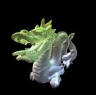
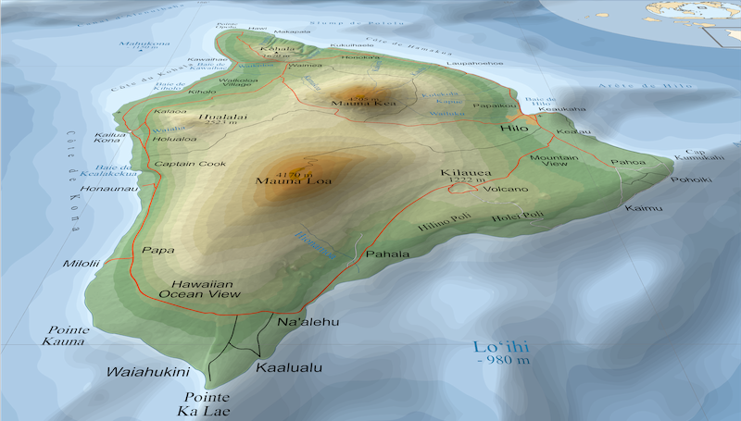
Alternative Rendering Pipelines
Point Pipeline
Voxel Pipeline
Vector Pipeline
Notes:
3D point data: http://kos.informatik.uni-osnabrueck.de/3Dscans/

Slide 8
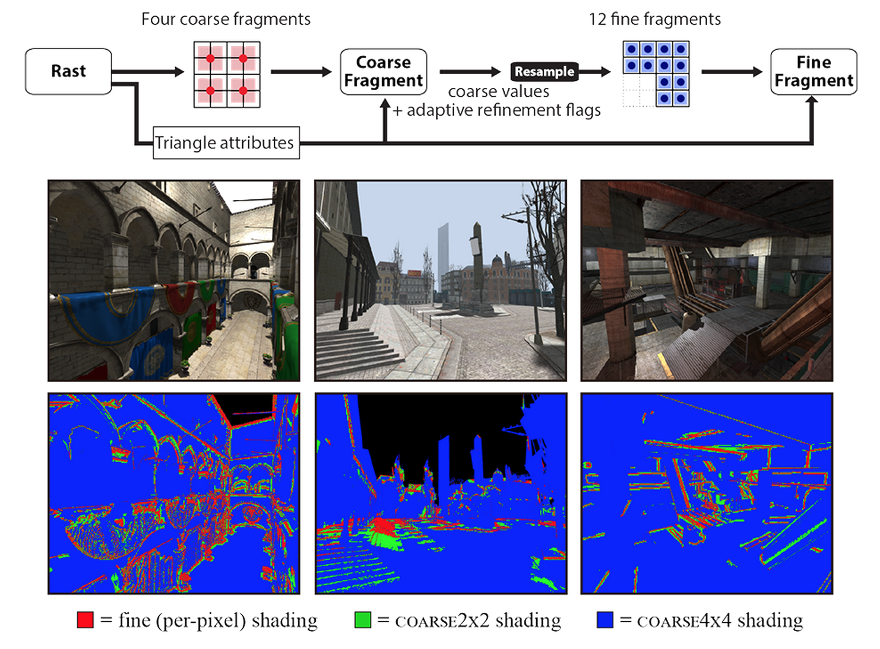
Extending the Graphics Pipeline with Adaptive, Multi-Rate Shading
http://graphics.cs.cmu.edu/projects/multirate/

Slide 9
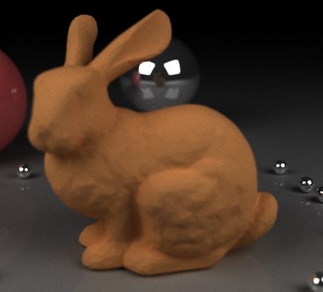
High-Quality Server-Side Rendering
Client-side WebGL
On mouse pause, server-side:
GPU path tracer, or
GPU Photon mapping
Image from http://www.colorseffectscode.com/Projects/FinalProject.html
Notes:
Low-res geometry, cheap shaders client-side. Server-side full geometry and shaders.

Slide 10
Distributed Rendering
In general, where is the client/server split?
All server, compress and stream
Create g-buffer server-side, light accumulate client-side
Temporal coherence
Image from http://shield.nvidia.com/
Notes:
Temporal coherence – what can we compute server-side and use for many frames?

Slide 11
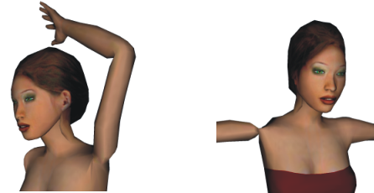
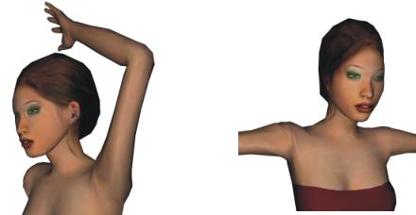
Skinning with Dual Quaternions Performance Analysis
http://www.seas.upenn.edu/~ladislav/dq/index.html
Notes:
Compute vs. memory bandwidth

Slide 12
WebGL Profiler
For widespread adoption, WebGL needs world-class developer tools. WebGL Inspection is a good start: http://benvanik.github.com/WebGL-Inspector/.
However, how do we profile our shaders? We want to mouse over a pixel and see the shader hotspots.
Image from http://benvanik.github.com/WebGL-Inspector/
Notes:
OK to limit to just fragment shaders
OK to group pixels into regions of pixels
Perhaps we modify the shader over several runs to determine the hotspots. Perhaps this is done automatically or with user-provided markup.

Slide 13
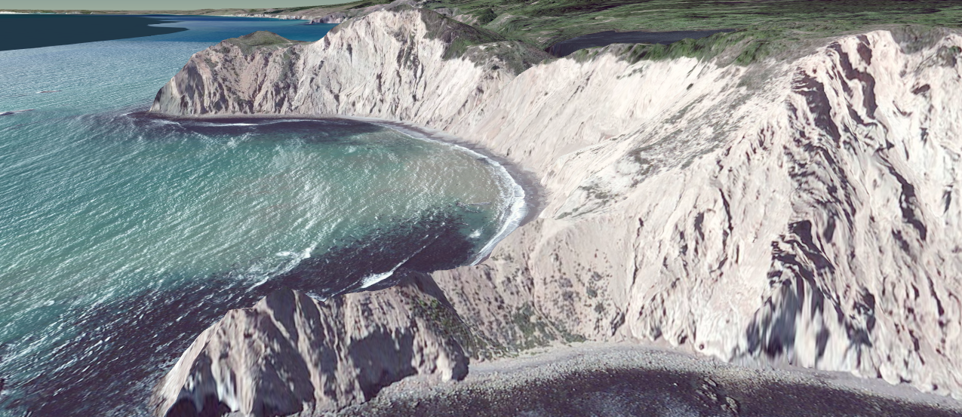
Precompute AO for terrain
Each vertex in parallel
Each ray in parallel
Consider local area only

Slide 14
HLSL to GLSL
Big industry need to one shading language
http://aras-p.info/blog/2012/10/01/cross-platform-shaders-in-2012/
“A non-crappy implementation of a library like this would almost certainly land you a job at Unity and I guess many other places.”

Slide 15
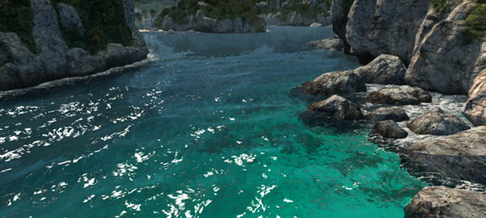
Water
http://www.fxguide.com/featured/assassins-creed-iii-the-tech-behind-or-beneath-the-action/

Slide 16
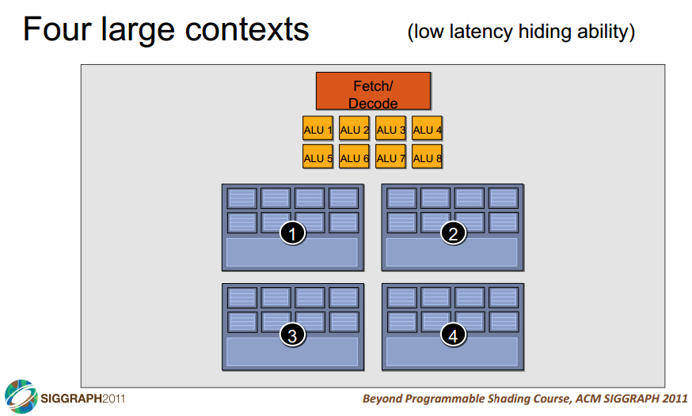
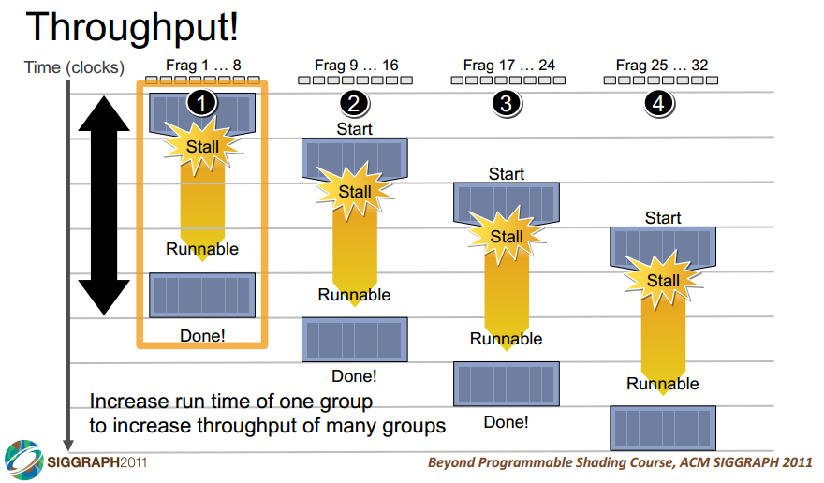
WebGL Tutorial for GPU Architecture

Slide 17
Mantle, Metal, D3D12
http://www.anandtech.com/show/7371/understanding-amds-mantle-a-lowlevel-graphics-api-for-gcn
Notes:
Lower draw call overhead. What are good use cases?
Compare with OpenGL performance

Slide 18
Sign up to Pitch Your Idea
https://docs.google.com/spreadsheets/d/1HN8DTvZrSQSvMYBlWQ7Z48YOqTYUrknHtl3EDZkP7mk/edit?usp=sharing

